Slide 1




Influence of ocean acidification on DNA methylation patterns in geoduck
Shelly Trigg, Ph.D.
School of Aquatic and Fishery Sciences
University of Washington
Collaborators: Putnam HM, Liachko I, Lawley C, White SJ, Spencer L, Vadopalas B, Natarajan A, Hetzel J, Jaeger E, Soohoo J, Goetz FW, Gallardo-Escárate C, Roberts SB
Notes:
This is a multi-year collaboration with Illumina, 10x Genomics, Phase Genomics, University of Rhode Island, and Universidad de Concepcion en Chile. I want to thank the workshop organizers, the NRSP for the funding to come and present, and current and past grants from NOAA and FFAR

Slide 2
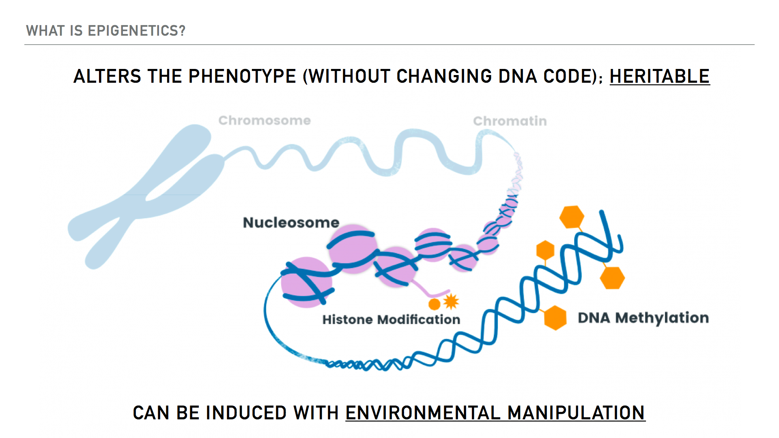
Notes:
So are chemical marks for instance on the DNA that can alter phenotype without changing the DNA code itself. And these marks can be passed on to offspring. These marks can also be induced by environmental manipulation

Slide 3
Notes:
Epigenetics is relevant to aquaculture because these marks could be to select for robust animals. We could influence these marks and phenotype through manipulating the environment of adult animals that could pass them on to offspring. Or influence the environment of early stage animals that could retain these marks and traits through their life.

Slide 4
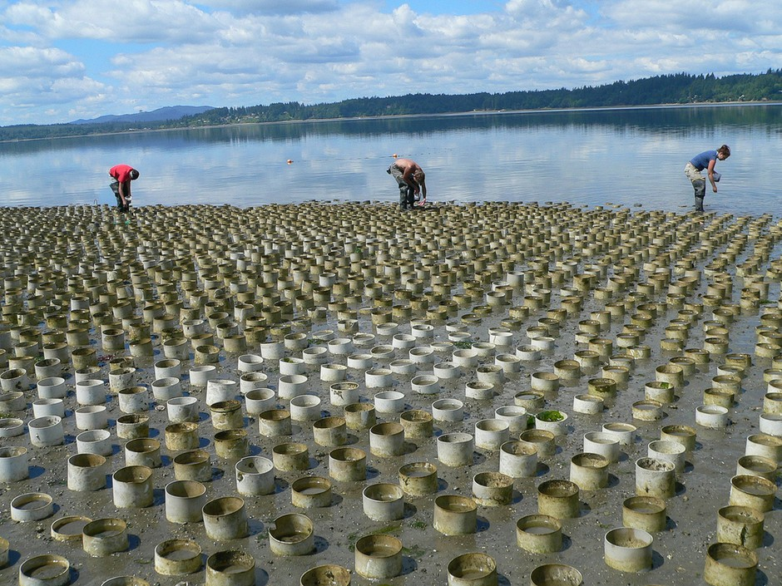
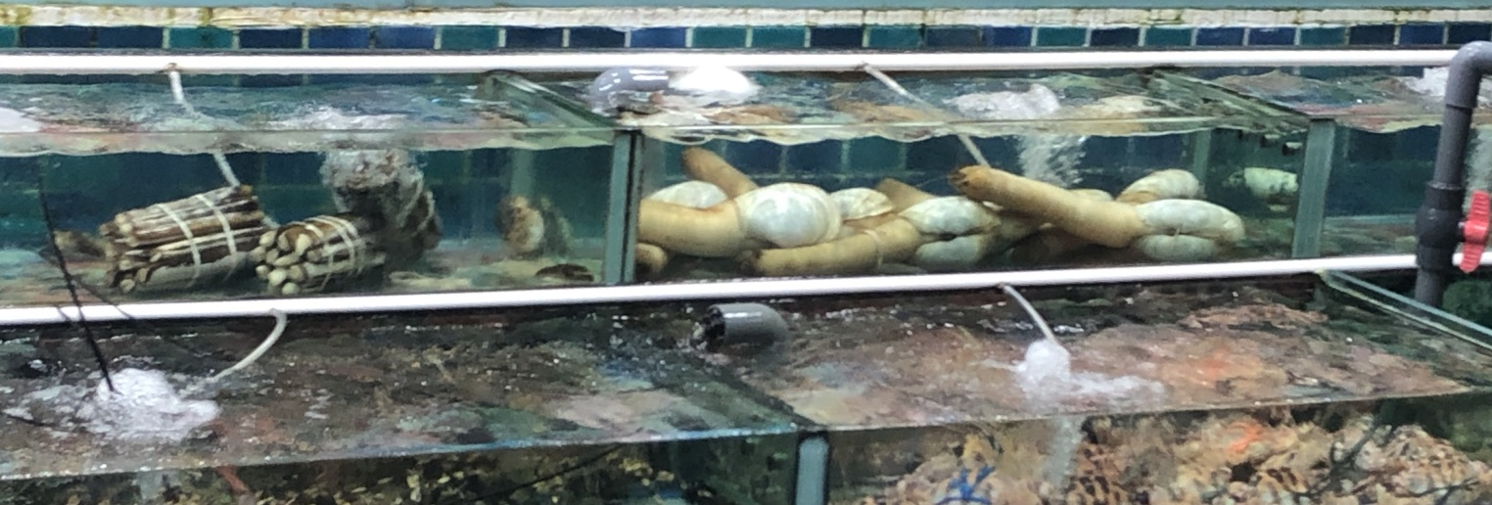
Geoduck (Panopea generosa)
Among most valuable farmed shellfish on a per acre basis
>$20 M in annual sales in Washington alone
Notes:
These are juvenile geoduck here and are about 3-5mm in size. In aquaculture, these are typically raised in a hatchery setting until this size and are then planted out in plots like this. This economically valuable and ecologically important species faces challenges during hatchery rearing and climate and global ocean change

Slide 5
Geoduck (Panopea generosa)
Genomic Resources
Identification of potential epigenetic markers underlying beneficial traits
Notes:
To develop strategies to face these challenges, we have been working towards developing genomic resources and identifying epigenetic markers underlying beneficial traits

Slide 6
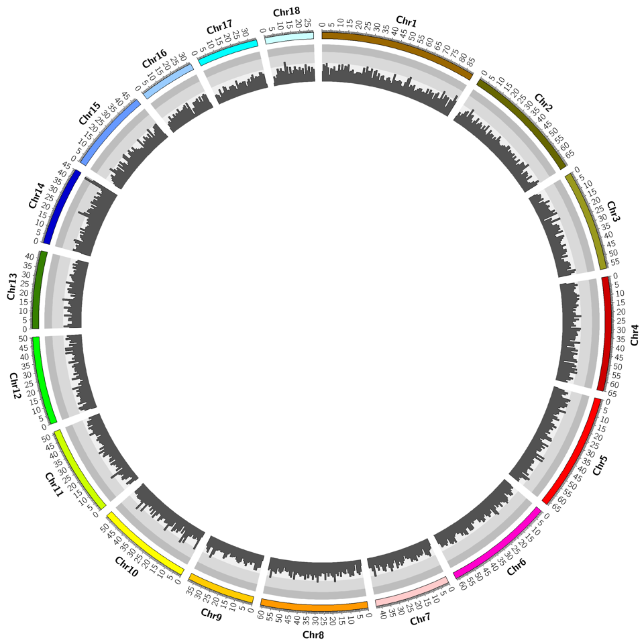
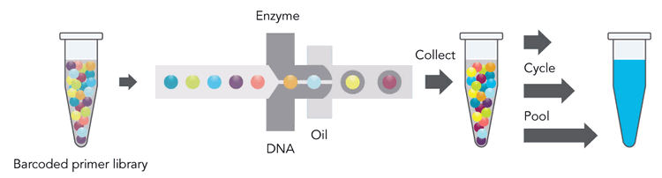
Draft Genome Assembly
10x Genomics
Linked-reads sequencing
Phase Genomics
Proximo Hi-C
18 Scaffolds
34,947 Genes
565,711 retro elements
259,955 transposons
42,601 sRNA
Notes:
We used 10x genomics technology of linked-reads sequencing coupled with phase genomics hi-C to assemble the geoduck genome. It consists of 18 scaffolds, almost 35K genese,

Slide 7
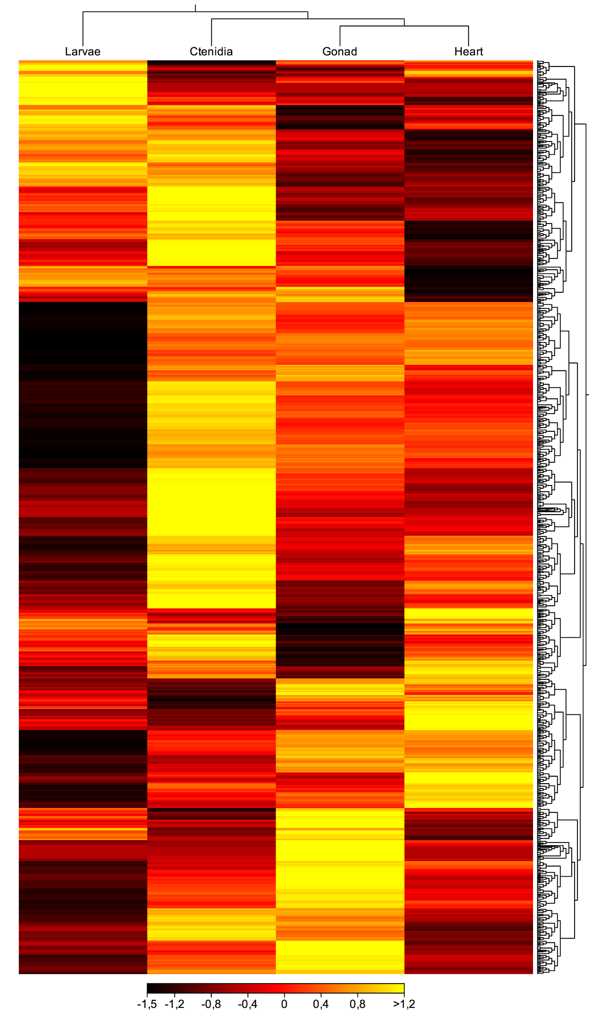
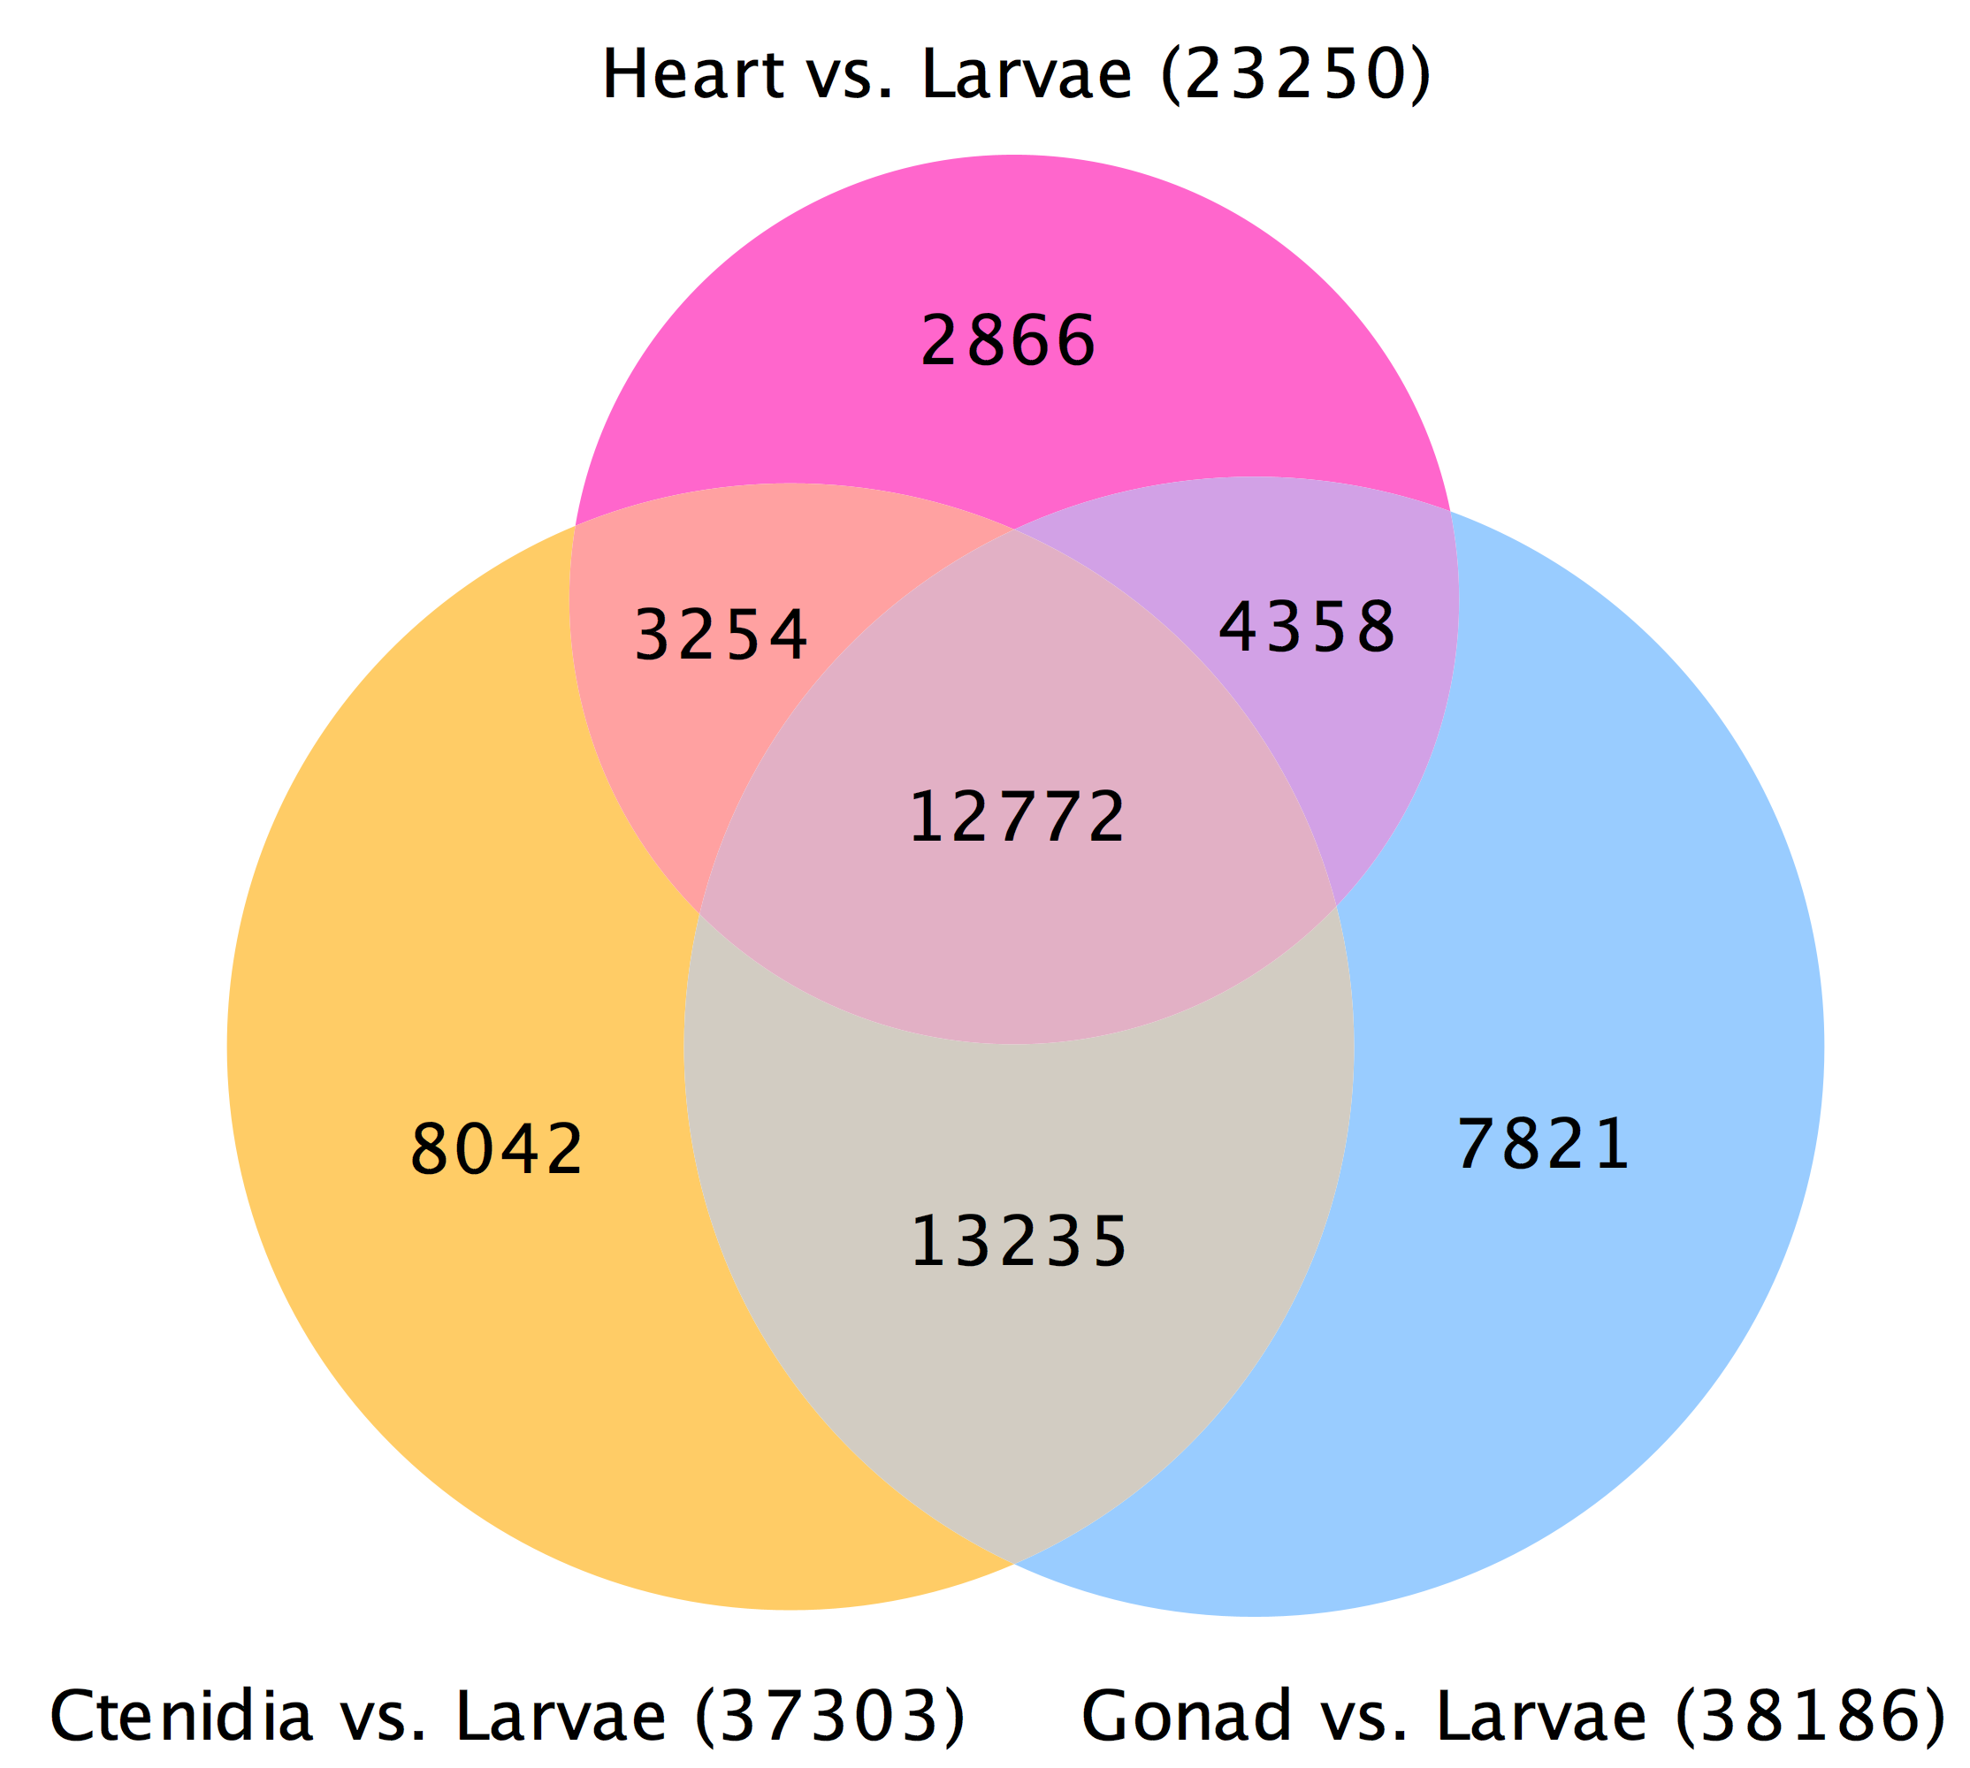
Long non-coding RNA
Notes:
We also examined a tissue specific transcriptomes and identified thousands of long non-coding RNAs which can play a role in gene regulation. This heatmap is showing the relative transcript abundance long non-coding RNAs in different tissues and larvae

Slide 8
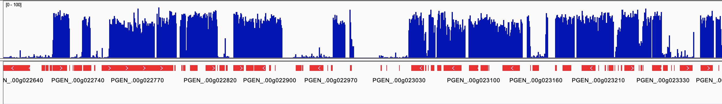
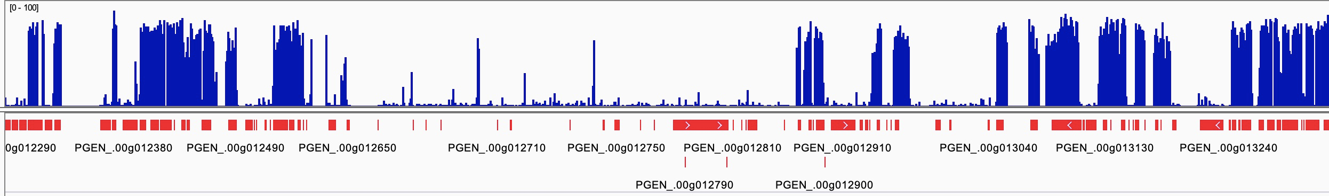
DNA Methylation Landscape
Notes:
This is a snap shot of the DNA methylation landscape of the genome which generally shows high methylation density within genes.

Slide 9
Geoduck (Panopea generosa)
Genomic Resources
Identification of potential epigenetic markers underlying beneficial traits
Notes:
In addition to developing these genomic resources, we have also been working on identification of potential epigenetic markers that underlie beneficial traits

Slide 10
Notes:
I’m specifically going to be talking about an experiment manipulating the environment of early stage animals to influence their phenotype later in life

Slide 11
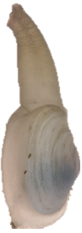
Altering early life environment pH
Initial Exposure
Common
Garden
Secondary Exposure
Ambient
Ambient
3 month old juveniles
Ambient
Low pH
Low pH
0
10
23
135
145
Days
Notes:
I’m going to walk you through this experimental set up. We took 3 month old juvenile clams and exposed them to low pH for a few weeks. We then moved the animals to a common garden in ambient conditions for a few months to see if initial exposure affected them long after the stress was removed. We then exposed them to low pH again to see if initial exposure affected their future stress tolerance

Slide 12
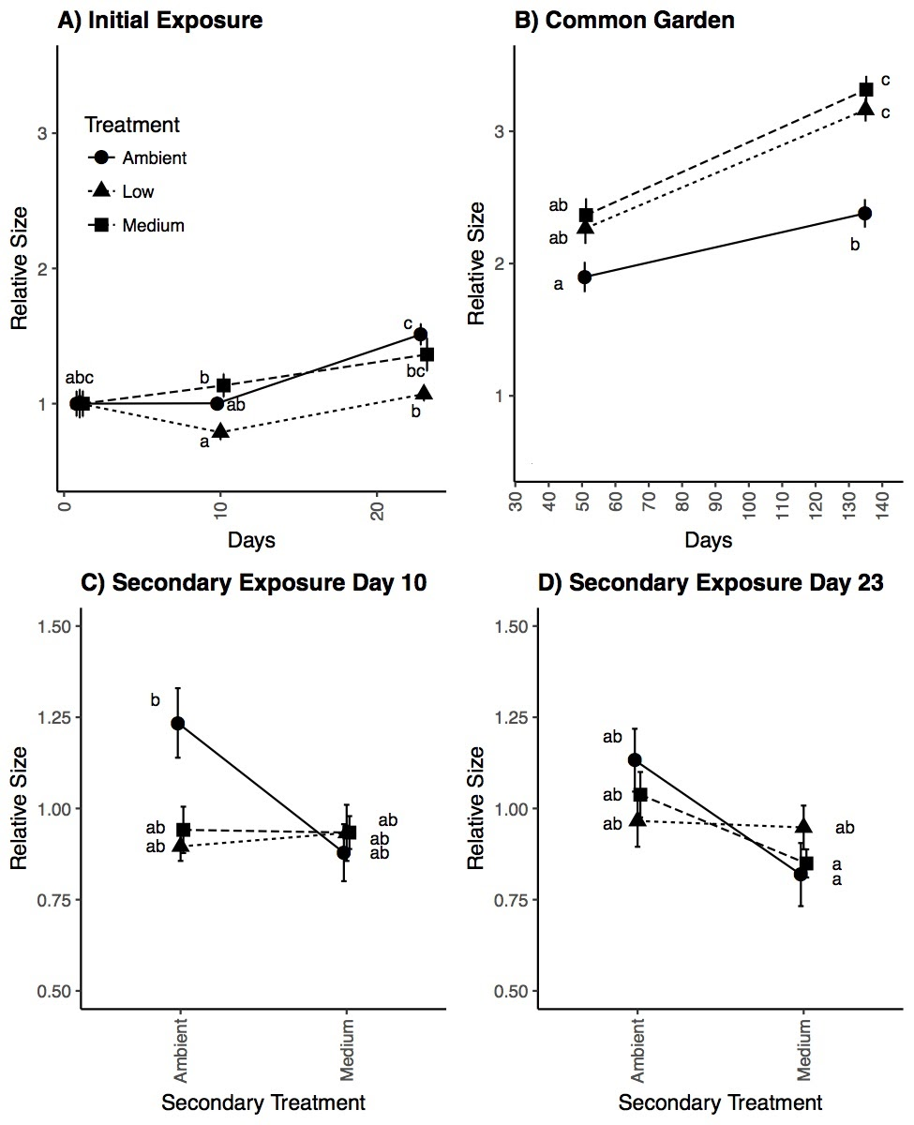
Initial low pH exposure leads to compensatory growth
pH 7.0
pH 7.4
Notes:
While there was no size difference during and after initial exposure, we did see initial low pH exposure led to compensatory growth after a few months in the common garden. So here we are looking at two different low pH groups and here is the ambient group. After 50 days at common garden we see larger size in the low pH groups and even more pronounced at 135 days. Size relative is the endpoint size relative to the common garden start size.

Slide 13
Does early pH exposure influence epigenetic marks that underlie compensatory growth phenotype?

Slide 14
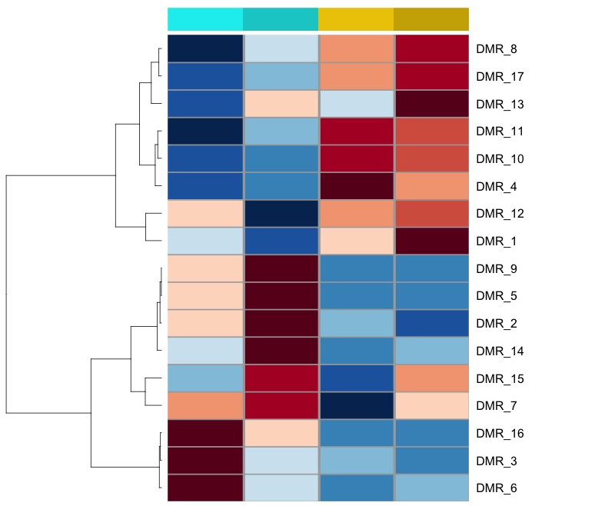
Initial low pH methylation marks persist
Initial exposure
ambient
low ph
initial exposure
common garden
initial exposure
common garden
Increased methylation
persists
Decreased methylation persists

Slide 15
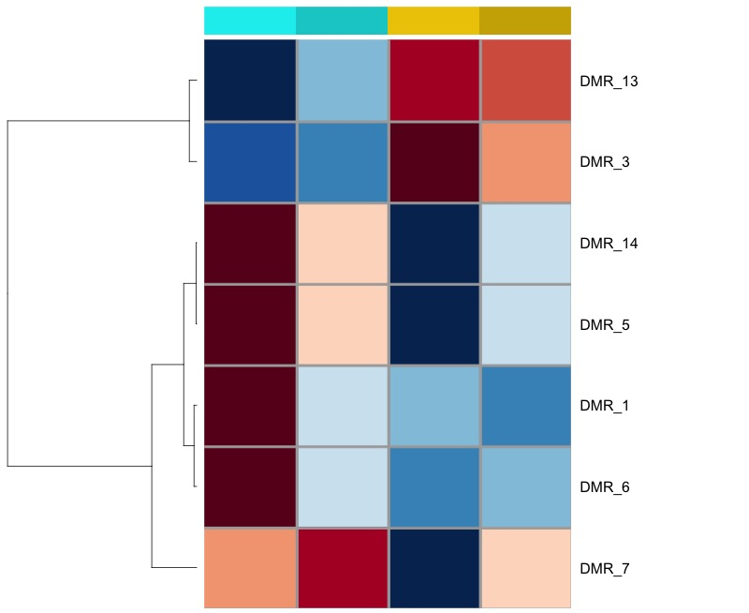
Initial low pH methylation marks persist
Initial exposure
ambient
low ph
initial exposure
common garden
initial exposure
common garden
Increased methylation
persists
Decreased methylation persists
Notes:
Here we are looking at methylation during initial exposure and after the common garden in both ambient (teal) and low pH (yellow) groups. The rows are differentially methylated regions of DNA with red indicating an increase in methylation and blue a decrease. We can see that these marks that are different after intial low pH exposure persist though time months after the pH stress was removed.

Slide 16
Initial low pH methylation marks persist
DMR_ID | Location | Methylation Change relative to ambient | Feature Type | Feature Name | distance | function
DMR_1 | Scaffold_01:42796927-42796976 | decrease | repeat | rnd-1_family-793 | 0 | no uniprot annotations
DMR_3 | Scaffold_01:59186898-59186958 | increase | gene | PGEN_.00g021750 | 0 | no uniprot annotations
DMR_5 | Scaffold_02:10983130-10983176 | decrease | repeat | rnd-1_family-826 | 0 | no uniprot annotations
DMR_7 | Scaffold_02:46872024-46872106 | decrease | repeat | rnd-5_family-2058 | 0 | no uniprot annotations
DMR_6 | Scaffold_02:28519662-28519931 | decrease | gene | PGEN_.00g043300 | 199 upstream | voltage sensitive calcium channel activity; large protein with multiple tissue specific isoforms (Annexin-7)
DMR_13 | Scaffold_03:56511986-56512009 | increase | repeat | rnd-6_family-1367 | 0 | no uniprot annotations
DMR_14 | Scaffold_04:40346615-40346636 | decrease | gene | PGEN_.00g094120 | 0 | no uniprot annotations
After initial exposure
After common garden
After initial exposure
After common garden
Initial exposure
ambient
pH 7.4
Notes:
This is a table showing the genomic features these marks overlap with some differentially methylated regions in genes and most in repeat regions. We don’t know the function of most of these features so we have to look further into these regions to understand how they could play a role in the compensatory growth phenotype.

Slide 17
Does early pH exposure influence response to later stress?

Slide 18
Evidence for environmental hardening
Secondary low pH exposure DOES NOT negatively affect size of juveniles initially exposed to low pH
Initial Treatment
pH 7.0
pH 7.4
pH 7.4
Notes:
We are now looking at the size of animals exposed at a later stage to either ambient conditions or low pH conditions. And you can see that animals only exposed to ambient pH, they were negatively affected when exposed to low pH at a later time, exhibiting a smaller size than their potential at ambient. While animals that were initially exposed to low pH showed no difference in size whether they were exposed to low pH or ambient conditions at this later time point.

Slide 19
Does early pH exposure influence epigenetic marks that underlie stress resistance phenotype?

Slide 20
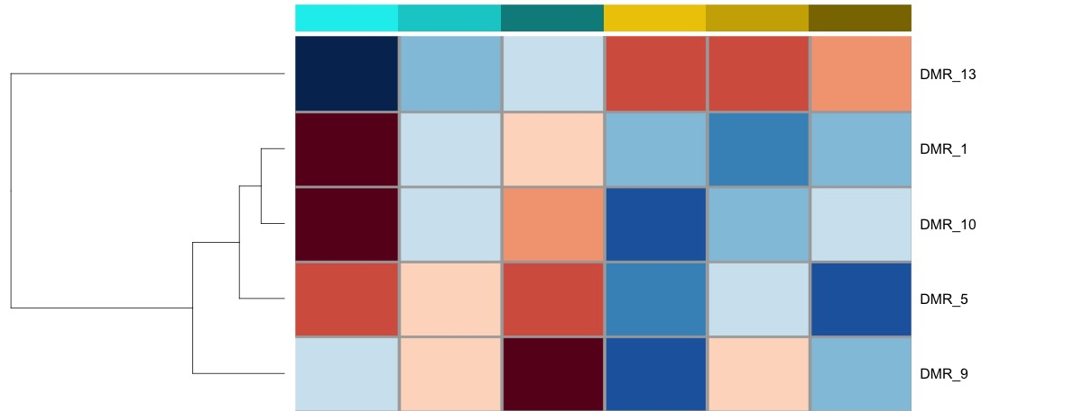
Potential epigenetic marks underlying environmental hardening
After initial exposure
After common garden
After
2nd exposure
After initial exposure
After common garden
After
2nd exposure
Initial exposure
ambient
pH 7.4
Increased methylation
persists
Decreased methylation persists
Notes:
Again here we are looking at methylation marks that show persistent differences over time being established after initial exposure, remain after stress is removed, and present during later stress. These marks could potentially underlie the growth phenotypes we observed. But could also be influenced by factors other than pH so we still need to further investigate these.

Slide 21
Summary
Identified positive growth phenotype
and potential associated epigenetic marks
Manipulated environmental pH

Slide 22
Summary
Do these epigenetic marks exist in adults?
Identified positive growth phenotype
and potential associated epigenetic marks
Manipulated environmental pH

Slide 23
Summary
Presentation + Resources:
github.com/shellytrigg/talk-pag2020
Do these epigenetic marks exist in adults?
Currently carrying out pH experiments on adults and their offspring
Identified positive growth phenotype
and potential associated epigenetic marks
Epigenetic marks could be used to select wild adults that would yield more robust offspring
Shelly Trigg
strigg@uw.edu
Manipulated environmental pH
Notes:
We are currently carrying out experiments in collaboration with Jamestown S’klaalam Pt. Whitney Hatchery to investigate pH influence on epigenetic marks and trains in adults and what gets passed on to offspring

